Slide 1


The road to saving Endangered Species
TFrazao

Slide 2
Summary
The main idea:
Different animals species are going extinct;
The causes are loss of habitat by climate changes or human activity.
Why I am doing it:
Each species has an important role in nature;
I would like to contribute to saving animals using web 3.0;
How am I do it:
By creating NFT protocol;
To raise money to “buy” an endangered species;
Trading unique NFTs with a build-in commission to the Charity Organization that protects a specific species.
Who are the players:
Developers – app development, investing
Curators/Investors – investing
Buyers/traders NFTs – provide on going funding
Members of DAO – buy access to voting
Animal Charities

Slide 3
Inspiration from workshops
My idea has a bit of inspiration from all the workshops and that is why I chose the general category since it doesn't fit inside of only one.
Community:
to let contributors have a key impact on the project's mission and key values, letting them by vote decide which species are important to save and which charities need the most;
to attract buyers and traders and grow the community by giving them positive feedback on their actions.
Tokenomics:
since endangered species are scarce, it helped me understand the potential value of this project by considering aspects of tokens creation and management including supply, in the end, an ecosystem mapping will be needed to determine more adequately the value flows.

Slide 4
Inspiration from workshops
Marketing:
to have a better understanding of the effective marketing channels to bring the community together, for example into Discord server, to give the community the sense of union and purpose towards a common goal and put educational resources like documentaries of the endangered species or other material provided by the charities.
Governance:
how to think about different ways of giving voting power to all members within the DAO, but for start, it would go for the traditional model. The importance of each vote will depend on how many tokens a member bought. Depending on the number of members, the governance will probably reside in creating working groups along with members.

Slide 5
How does it add value to web3?
The value that brings to Web 3.0 is to connect digital assets to the real world by using the Unique Identifiers (Uids) related to a determined animal. As a result, there is a digital scarcity of the digital asset as the production of the NFTs is effectively tied to the existence of a determined animal. Which are the Unique Identifiers? These NFTs can include high-resolution photography, audio recordings of sound calls, and DNA sampling to obtain a DNA sequence format file. Since these animals are unique, these NFTs tokens are auctioned as an ERC721 token. When an NFT is traded, a commission can be sent to the original creator/curator of the NFT, and a build-in commission is sent to the Charity Organization on every sale and re-sale of the NFTs. That way it would provide ongoing funding.

Slide 6
What problem does it solve?
Using Uids helps to solve the problem that NFTs exist besides a website link and this link directs the owners of the NFTs to an actual live unique animal that has certain intrinsic characteristics that also need their help to continue living in its habitat. In a way, the NFT lives while the animal lives, as long as that animal exists in the world, the NFT retains value as long as the Charity, the owner, the DAO, and prospective buyers agree on what the NFT token is and is meant to represent. It is a system built-in trust. Optimally the NFT will have a traditional digital written contract in itself that tells what the buyer is getting that automatically can change from owner to owner.

Slide 7
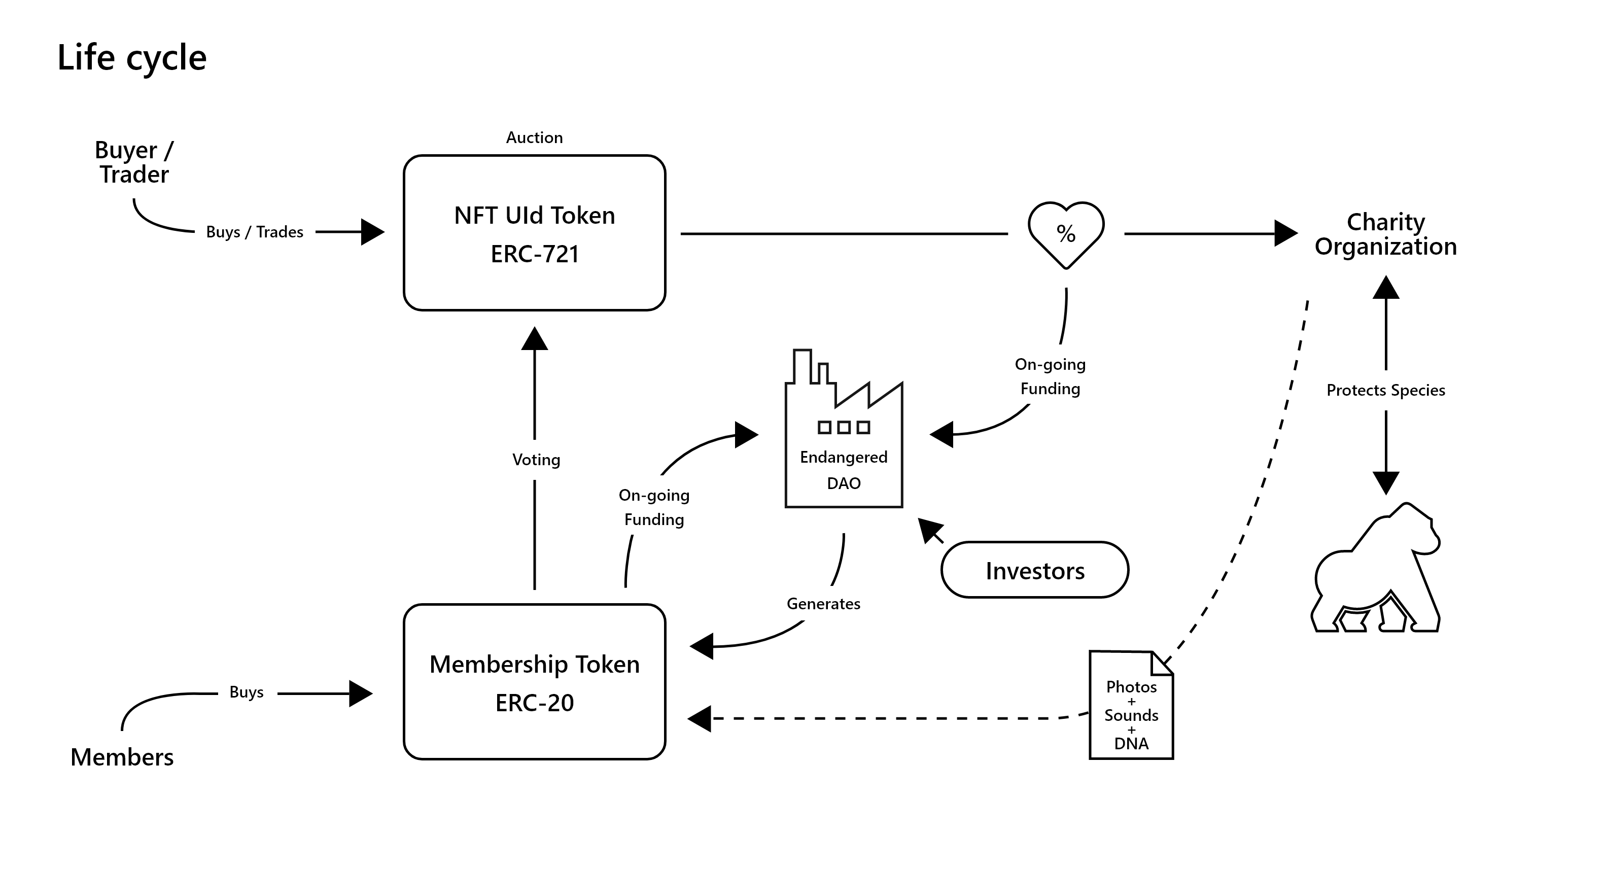
Solution
Life cycle
View image in more detail.

Slide 8
Solution
Life cycle
Briefly, Endangered DAO will produce two tokens. An ERC-721 token for an auction whose percentage of the sale will go to the organization responsible for the protection of the endangered species. The other ERC-20 token will be issued by the DAO so that its purchase allows its holders to have a vote in all DAO decisions. When an ERC-721 NFT is traded there is a build-in commission to the Charity Organization on every sale and re-sale of the NFTs. That way it would provide ongoing funding for the charities and the DAO. The Charities are considered partners since they provide the material to the DAO related to the ID of the animal, such as high-resolution photos, the animal sounds, or the DNA file format. This material is then subjected to vote and after, put to sale.

Slide 9
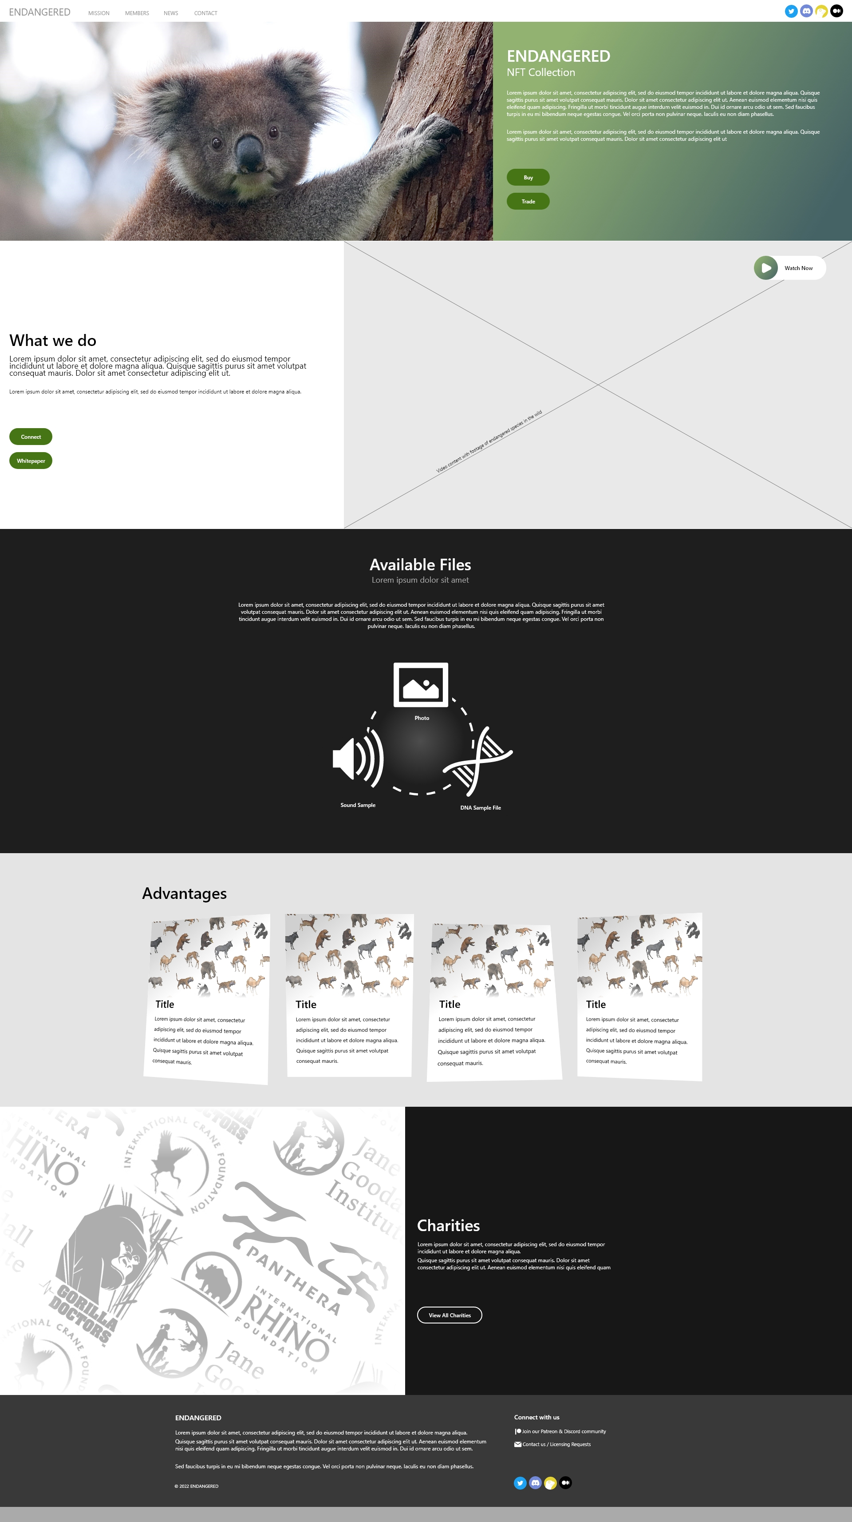
Solution
Hypothetical dApp Design
View Website Design in more detail.

Slide 10
Future
Later Project
If Constitution DAO was able to raise enough capital to stand a chance at buying a copy of the constitution, then perhaps a similar NFT protocol could raise enough money to 'buy' an endangered species. The "Endangered DAO" would probably need to buy some land as well. Ideally, people would need to buy "the guaranteed survival of the species, in perpetuity". It will involve, land, wildlife monitoring, and protection services. There would be ongoing expenses making it a challenge but also very interesting.

Slide 11
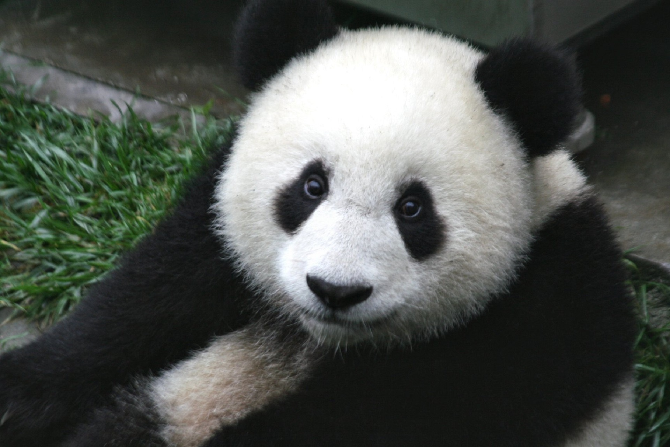

Saving Endangered Species
Thank you for the opportunity to show my project.
[Codeless Conduct] - Open Track – General
09th March 2022
@GorgeousTech

